Slide 1
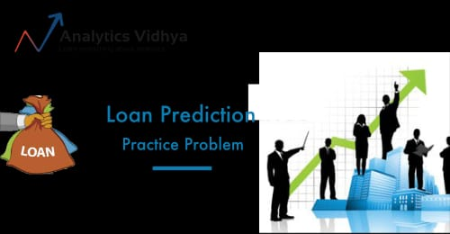
This Photo by Unknown author is licensed under CC BY-SA.

Slide 2


loan status prediction using exploratory data anlysis
Submitted by:
TEAM NO: CSE 010
TEAM NAME: Dreamer’s
Jafreen Sana Nousheen
Samala Saipranathi
Sneha Tingilkar
Dandi Sumasri
This Photo by Unknown author is licensed under CC BY.

Slide 3

What is Loan Status
Loan prediction is a very common real-life problem that each retail bank faces at least once in its lifetime.
The term banking can be defined as receiving and protecting money that is deposited by the individual or the entities.
Loans are good sum of money borrowed for a period and expected to be paid back at given interest rate. Loans are broadly divided as open-ended and close-ended loans.
Open-ended loans are the loans for which the client has approval for a specific amount.
Close-ended loans decreases with each payment.
Loan prediction is a very common real-life problem that each retail bank faces at least once in its lifetime.
The term banking can be defined as receiving and protecting money that is deposited by the individual or the entities.
Loans are good sum of money borrowed for a period and expected to be paid back at given interest rate. Loans are broadly divided as open-ended and close-ended loans.
Open-ended loans are the loans for which the client has approval for a specific amount.
Close-ended loans decreases with each payment.

Slide 4

DATA SOURCE
It has information about applicant’s income,co-applicant income,no.of dependetnce,graduated ,self employed,loan amount,loan amount term,credit history and property area
For this project ‘Loan status’ has been picked ,which is available on dataset websites
This data consists records of 615 Applicants
It has information about Applicant’s of Gender,Married,dependents,graduation,self-employed,Applicant income,Coapplicant income,Loan amount,Loan amount term,Credit history,Property area etc.

Slide 5

Describe the dataset
Dream Housing Finance company deals in all home loans. They have presence across all urban, semi urban and rural areas. Customer first apply for home loan after that company validates the customer eligibility for loan. Company wants to automate the loan eligibility process (real time) based on customer detail provided while filling online application form.
These details are Gender, Marital Status, Education, Number of Dependents, Income, Loan Amount, Credit History and others. To automate this process, they have given a problem to identify the customers segments, those are eligible for loan amount so that they can specifically target these customers.

Slide 6
Steps
Import Libraries and read data set
Describe the dataset
Data Transformation / Categorical to Numerical
Data Cleaning and Feature Selection
Split the dataset into train and test set
Machine Learning Modeling
train the model (Fit)
Test the trained model (prediction )
Model Evaluation

Slide 7

Import Libraries and read data set
** Import some libraries that will be used throughout the program.**
import numpy as np
import pandas as pd
import ibm learn
import pickle
import sklearn
This Photo by Unknown author is licensed under CC BY-NC-ND.

Slide 8

Data preprocessing
Here the data of numerical values were replaced by mean and categorical were replaced by median
*Data Cleaning and Feature Selection
Data cleaning is the process of fixing or removing incorrect, corrupted, incorrectly formatted, duplicate, or incomplete data within a dataset.
df.isnull().any()

Slide 9
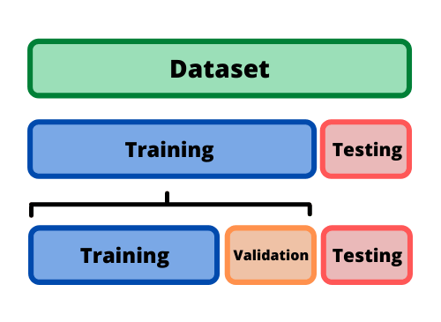
TRAINING AND TEST DATA
Split the dataset into train and test set
* Train/Test is a method to measure the accuracy of your model.
*Training data sets are sets on which you train your machine i.e algorithm to form relationships between variables.
*Testing data set helps you to validate that the training has happened efficiently in terms of either accuracy, or precision so on.

Slide 10
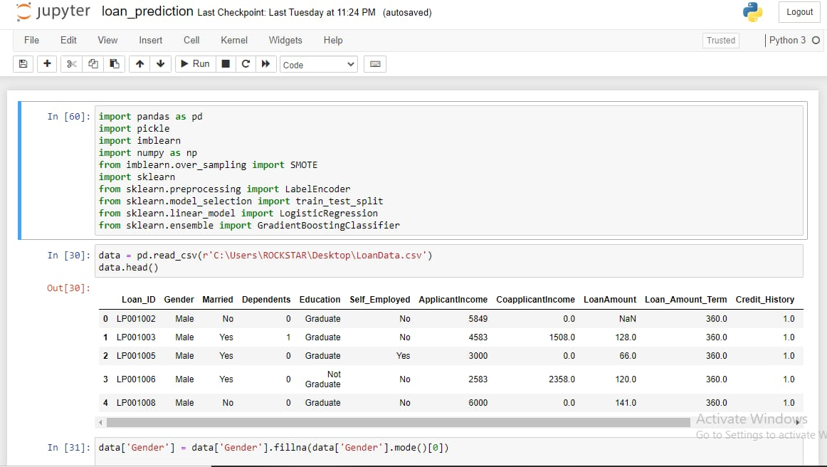
Click to text

Slide 11
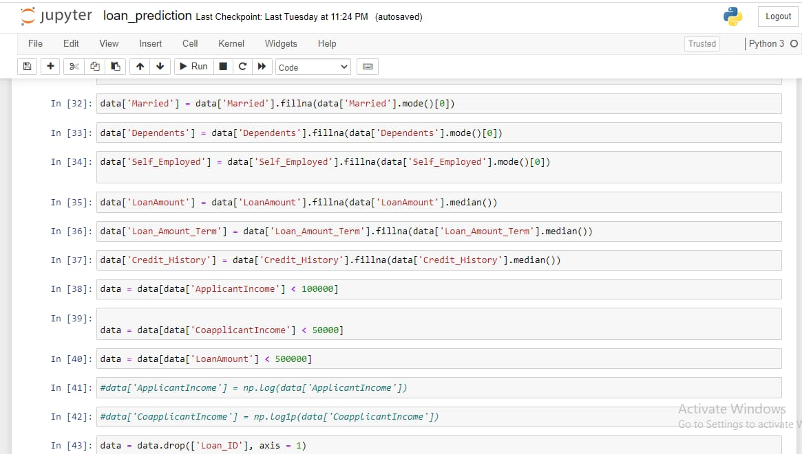

Slide 12
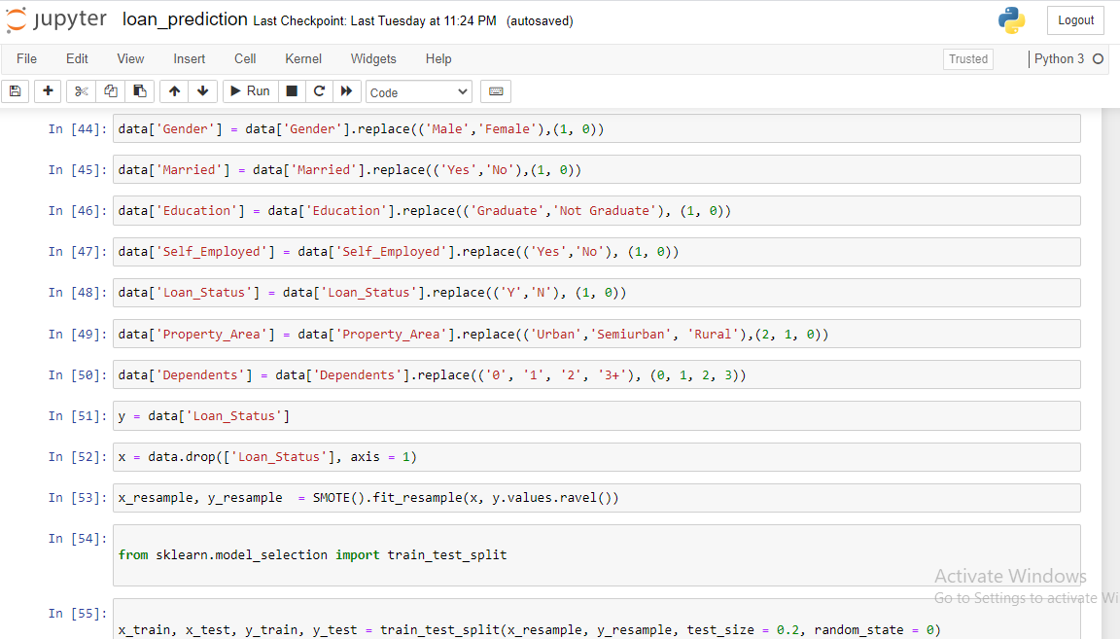

Slide 13
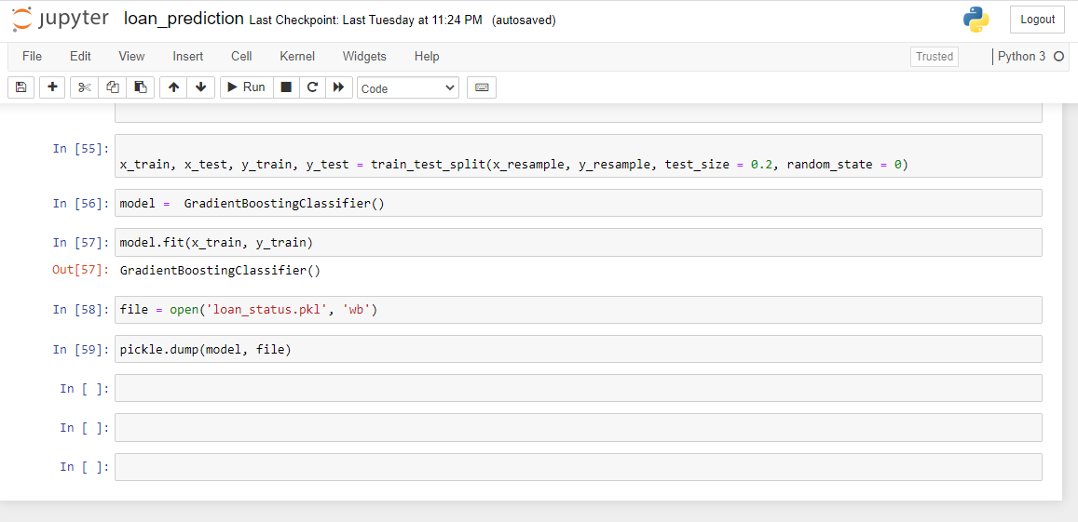

Slide 14
Exploratory Data Analysis:
Well don’t get to worry about the fancy names like exploratory data analysis and all. By looking at the columns description in the above paragraph, we can make many assumptions like ∙ The one whose salary is more can have a greater chance of loan approval. ∙ The one who is graduate has a better chance of loan approval. ∙ Married people would have a upper hand than unmarried people for loan approval . ∙ The applicant who has less number of dependents have a high probability for loan approval. ∙ The lesser the loan amount the higher the chance for getting loan.

Slide 15
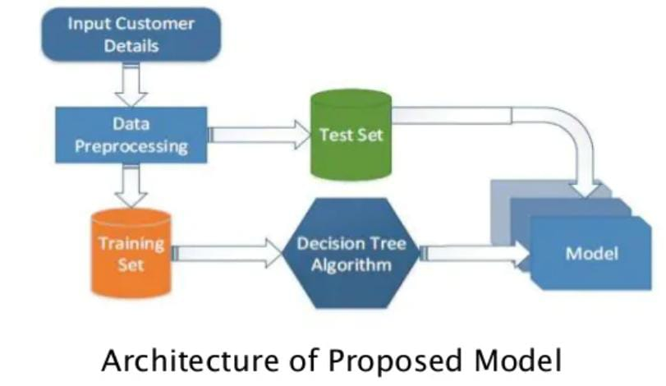
ALGORITHM:
The following shows the pseudo code for the proposed
loan prediction method
1. Load the data
2. Determine the training and testing data
3. Data cleaning and pre-processing.
a) Fill the missing values with mean values regarding
numerical values.
b) Fill the missing values with mode values regarding
categorical variables.c) Outlier treatment.
4. Apply the modelling for prediction
a) Removing the load identifier
b) Create the target variable (based on the requirement).
In this approach, target variable is loan-status
c) Create a dummy variable for categorical variable (if
required) and split the training and testing data for
validation.
d) Apply the model: NB method, SVM method
5. Determine the accuracy followed by confusion Matrix.

Slide 16
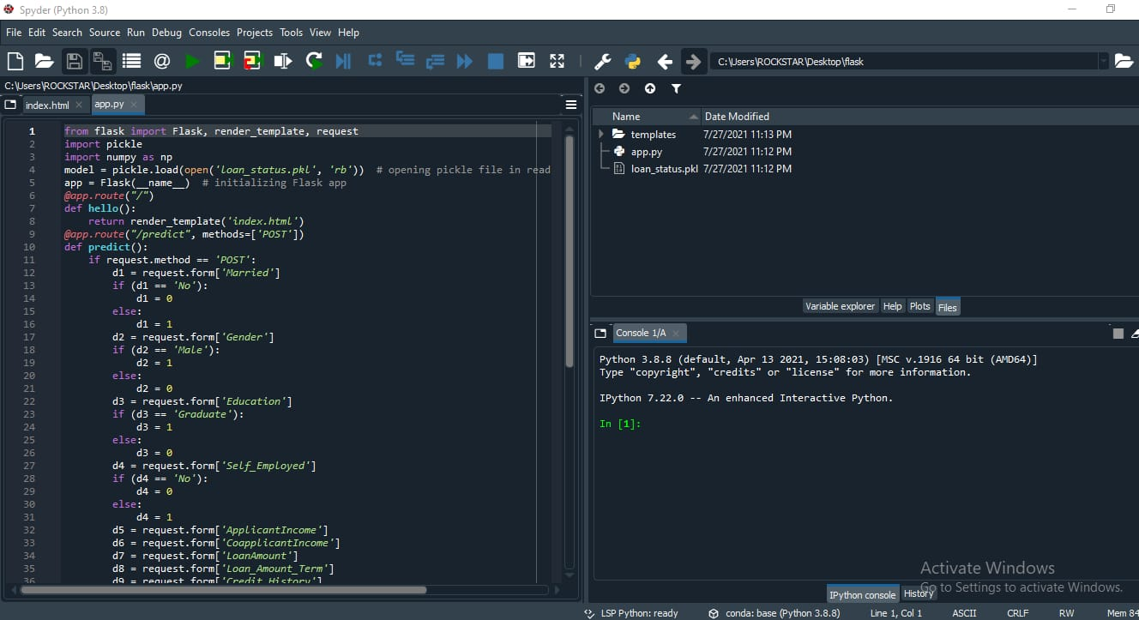


Slide 17
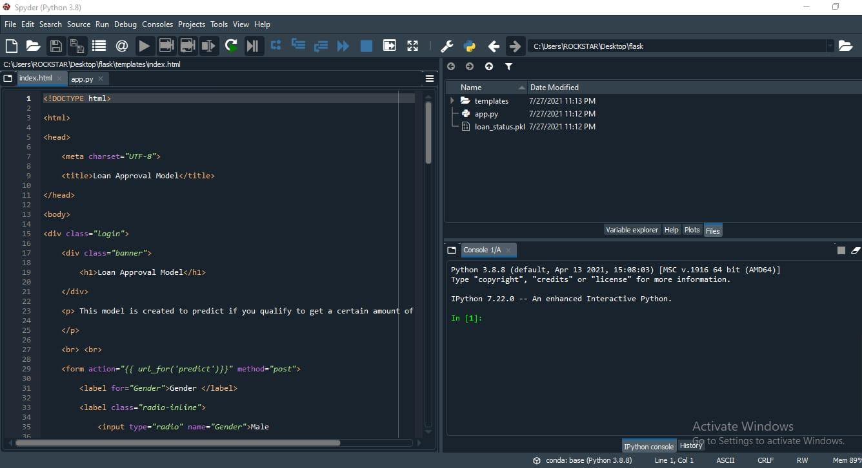

Slide 18
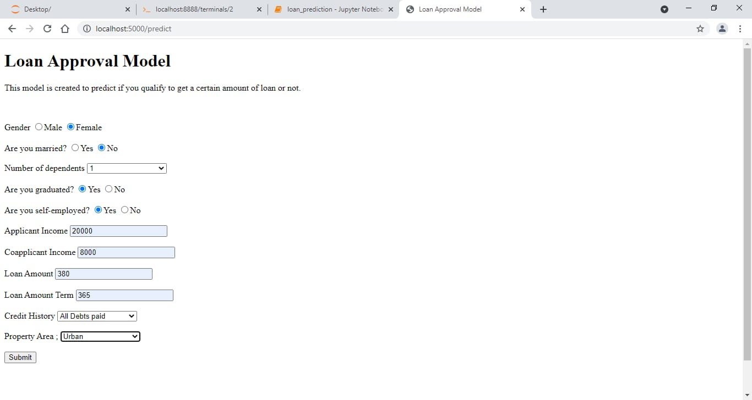

Slide 19
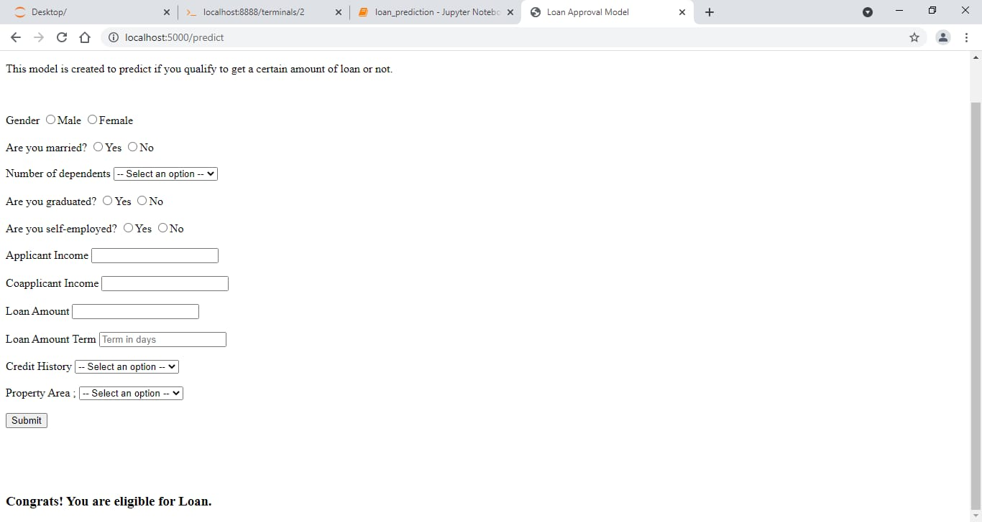

Slide 20
Conclusion:
We have proposed an efficient and reliable bridge for loan status prediction, when there is urgent need for people to take loan it may not be possible for people to communicate with each and every bank status for that loan status prediction can fulfill their requirements in short time span. So , that it can overcome the rate. Thus the proposed website can help people who is need of anytime and anywhere. This website is very useful for smart City and smart nation purpose

Slide 21



